Slide 1
Welcome to Cherry class

Slide 2
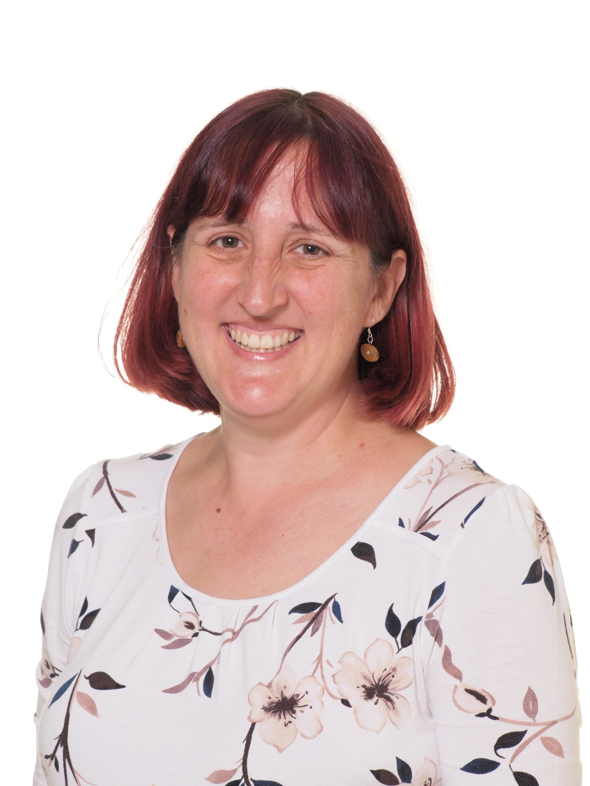
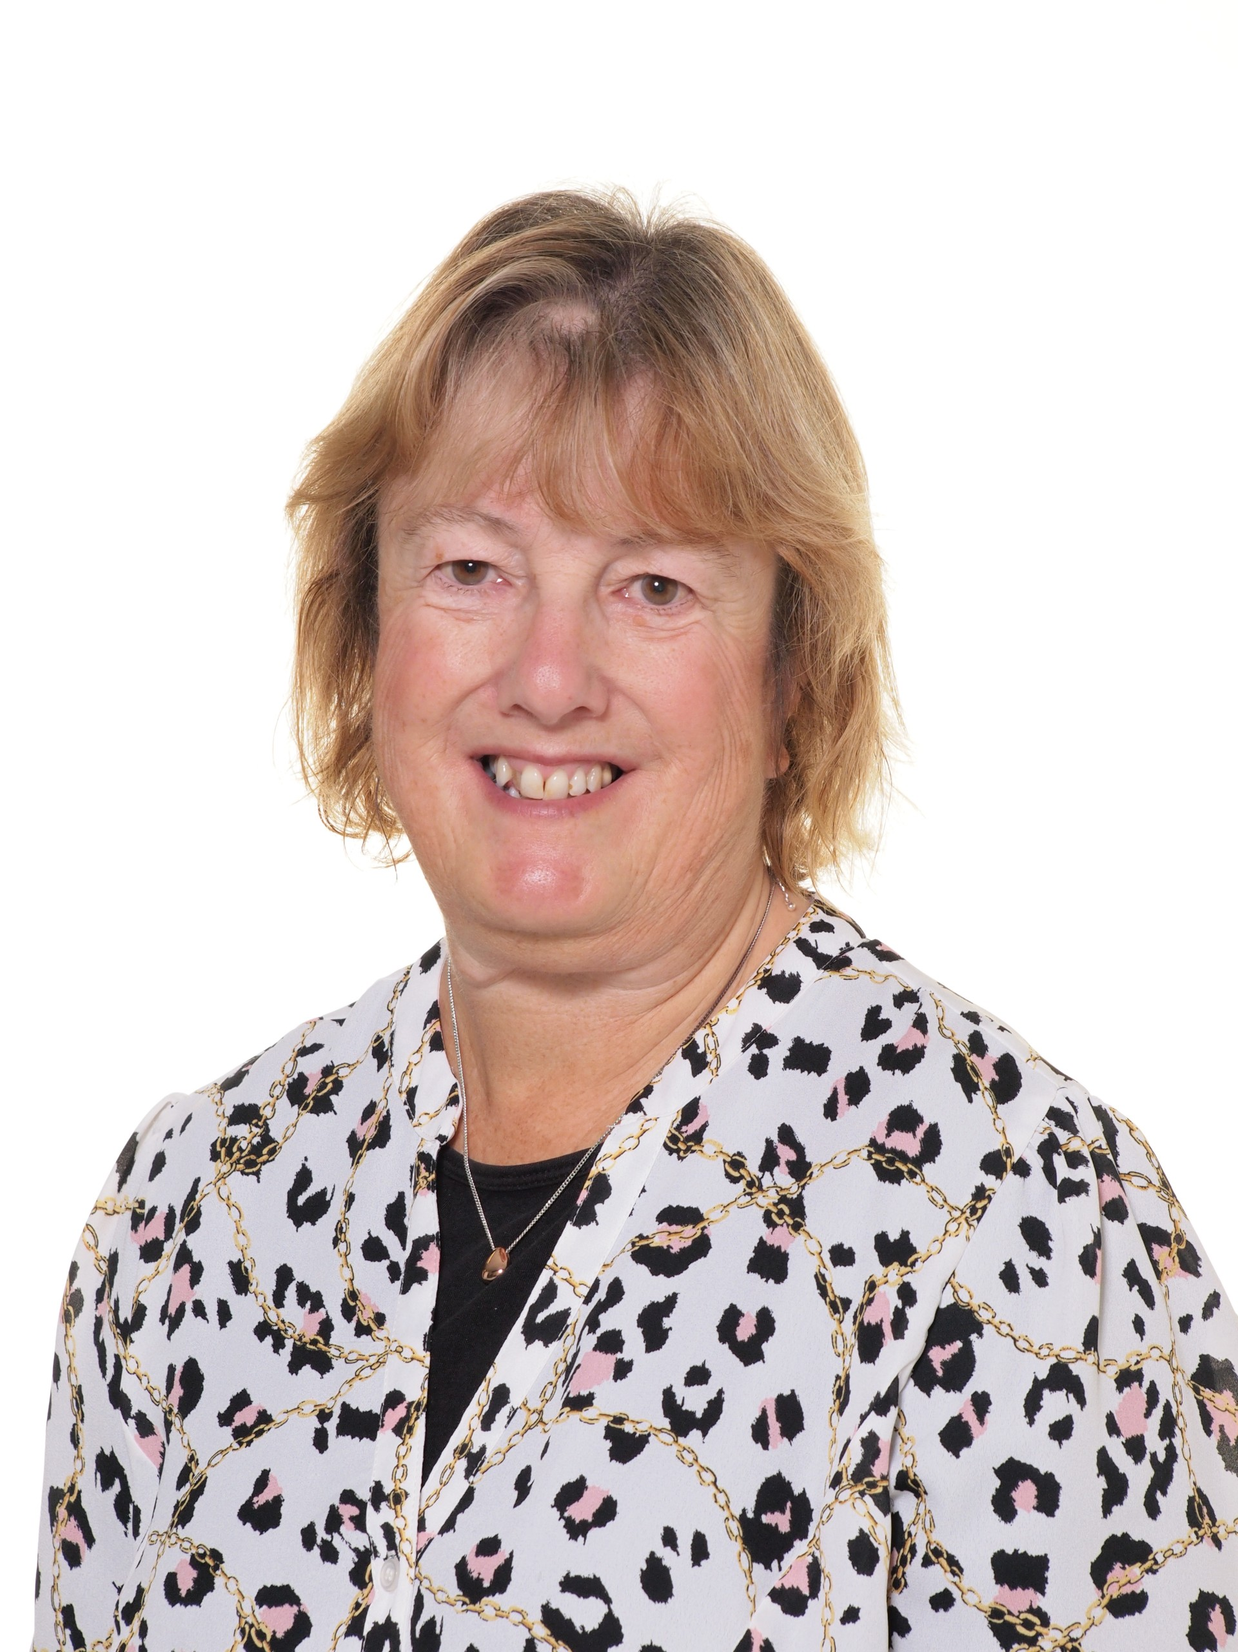
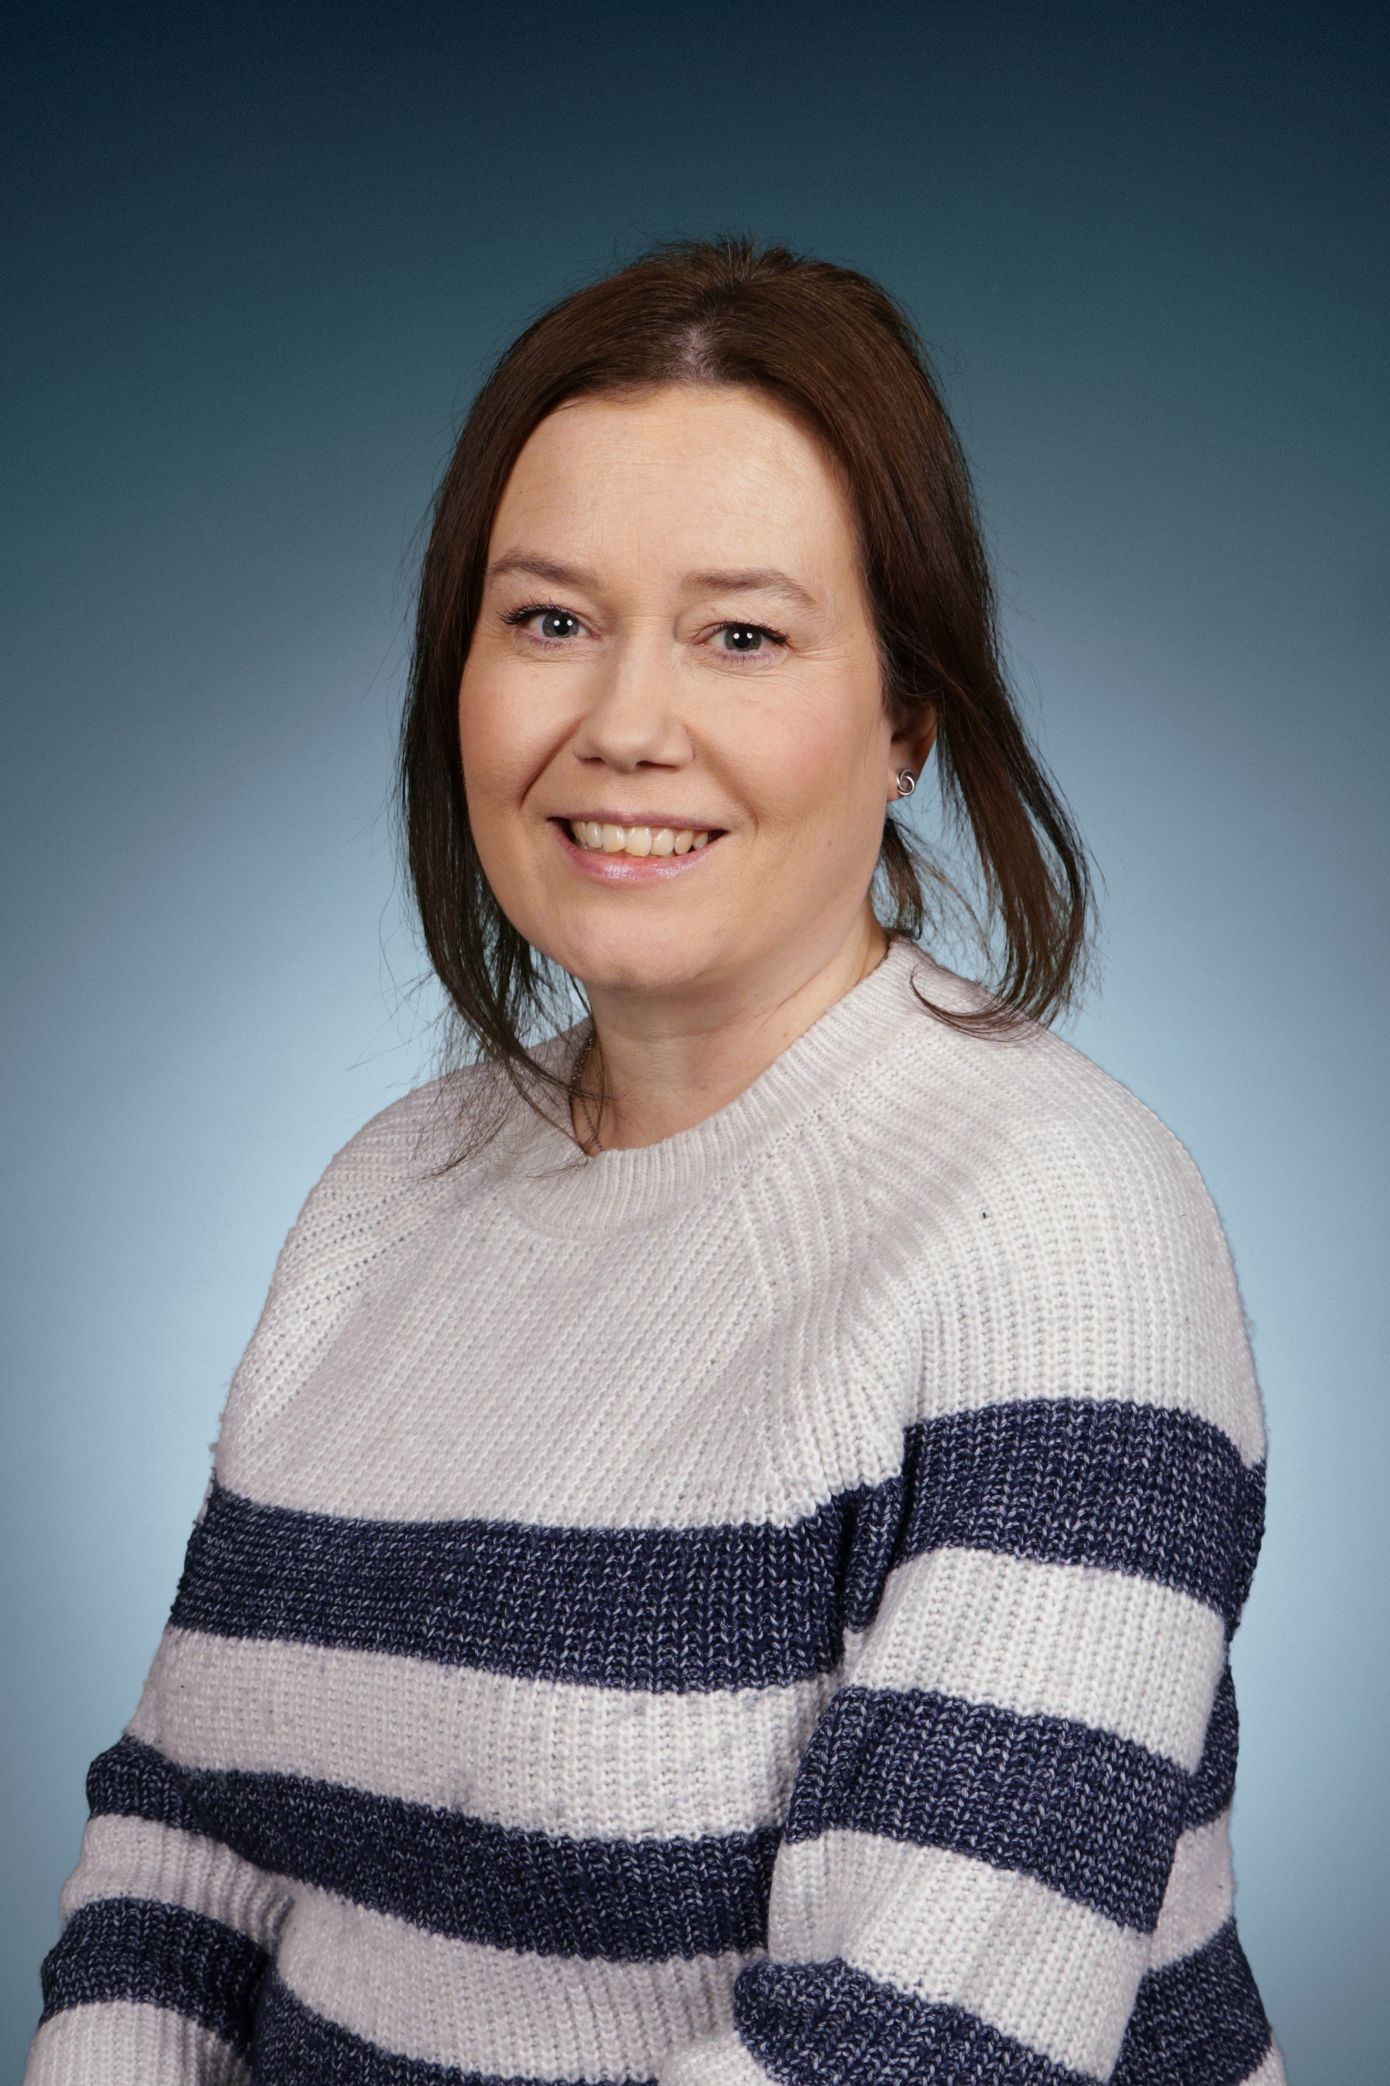
Meet The cherry class team
Mrs Miller
Class Teacher
Miss Arden
Teaching Assistant
Mrs Gibbings
Teaching Assistant
Mrs Mead
Teaching Assistant
Mrs Skinner
Teaching Assistant
Mrs Wakefield
Teaching Assistant
Mrs Whitmill
Teaching Assistant
Mrs Lynch
Midday Supervisor

Slide 3
Early Years Foundation Stage Framework
We follow a play-based curriculum, routed in the key principles of the EYFS Framework.
We cover seven areas of learning which consist of three Prime areas: Physical Development, Personal, Social and Emotional Development, Communication and Language and four Specific Areas: Literacy, Mathematics, Expressive Arts and Design and Understanding the World.
All areas are interlinked, and underpinned by the Characteristics of Effective Learning, which are positive learning behaviours.
Our curriculum ensures that children have the knowledge and skills they need to support them as they move through school.
Staff will support the children with their learning and development through play.

Slide 4
clothing
Children don’t need to wear uniform but in practice many do wear polo shirts and school jumpers with either joggers or leggings.
The school now have a green uniform, we do have a pre-loved clothing rack in the entrance.
Jumpers and t-shirts with the school logo on can be purchased online from www.price-buckland.co.uk
Plain jumpers and cardigans can also be bought widely from clothing stores and larger supermarkets.
Change of clothes in school – look out for a yellow note in their bag.

Slide 5
Outdoor clothing
The children go outside into the EYFS playground in all weather, unless it is unsafe to do so.
If possible, please can you provide your child with wellington boots, a waterproof coat and waterproof trousers to be kept in school. This will ensure that they can make the most of learning opportunities outside in all weather.
It is also helpful if your child can already independently put their coat on and remove their shoes and put on welly boots – but we will help them to learn to do this.

Slide 6
Drop off and collection
Morning sessions start at 9am and finish at 12 noon.
Afternoon sessions start at 12 noon and finish at 3pm.
Please use the Cherry door for drop off and collection – school office at all other times of day.
Please ensure you are on time as it can be very distressing for young children to arrive later than others or to be left on the carpet when everyone else has gone home.
Please bear with us as we try to match the adult to the child at the end of the day initially. We will get there over the first few weeks and this should then speed the process up for everyone!

Slide 7
Snacks and drinks
Please ensure that your child brings a water bottle with them. This should be taken home, cleaned and refilled at the end of each session.
Children have access to free fruit and milk throughout session times.
If your child is staying for lunch, they will need to bring a packed lunch with them.
Packed lunches need to be healthy, no nuts, sweets or chocolate bars.
We eat lunch together in Cherry Class.

Slide 8
Parents as partners
Parents will be given a scrapbook to complete with their child about their family and all the things they get up to at home. These will be sent home periodically over the course of the year.
Parents are invited to termly review meetings in the Autumn and Spring terms and will receive a written report in the summer term.
Parents may also see a member of staff at other times during the term if you have any concerns or would just like to see how your child is progressing. If you have any queries or worries, please do not hesitate to speak to us.
We will post regular updates and reminders through the Facebook group and via Parentmail.

Slide 9
SCRAPBOOKS

Slide 10
Home visits and starting dates
Visits to Cherry Class:
If your child attends Acorn Pre-School, they will visit in groups with Acorn staff.
If your child does not attend Acorn, you will have been invited in via Parentmail to attend on the 4th July at 10.30 or 1.30
Home visits:
Wednesday 3rd – Tuesday 9th September 2025 – book via Parentmail.
Pre home visit form to complete – via Parentmail.
Stay & Play sessions:
Friday 5th – Tuesday 9th September 2025 - 2-3pm – book via Parentmail.
Staggered start sessions:
Wednesday 10th – Friday 12th September 2025 – book via Parentmail. 2 sessions per child – not staying for lunch.
All children in doing their full hours from week beginning Monday 15th September 2025.

